Slide 1
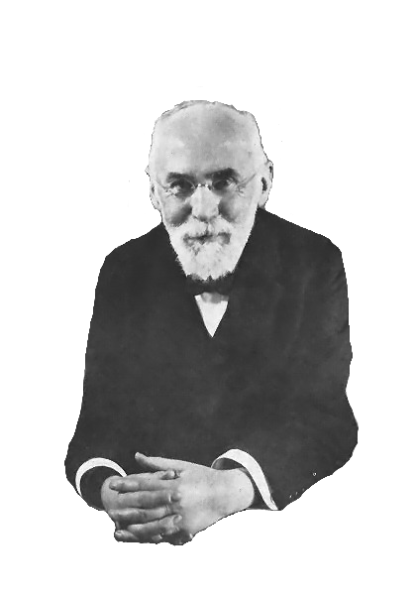
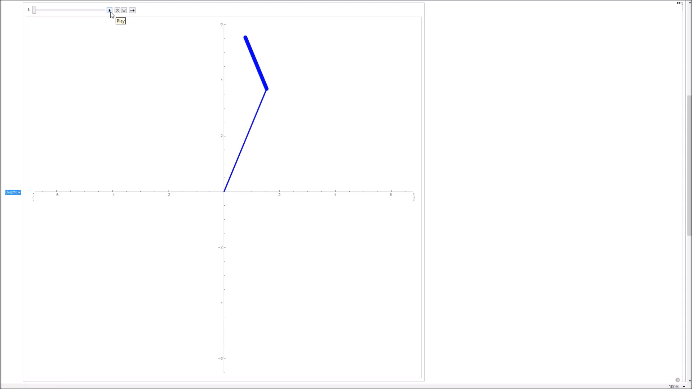

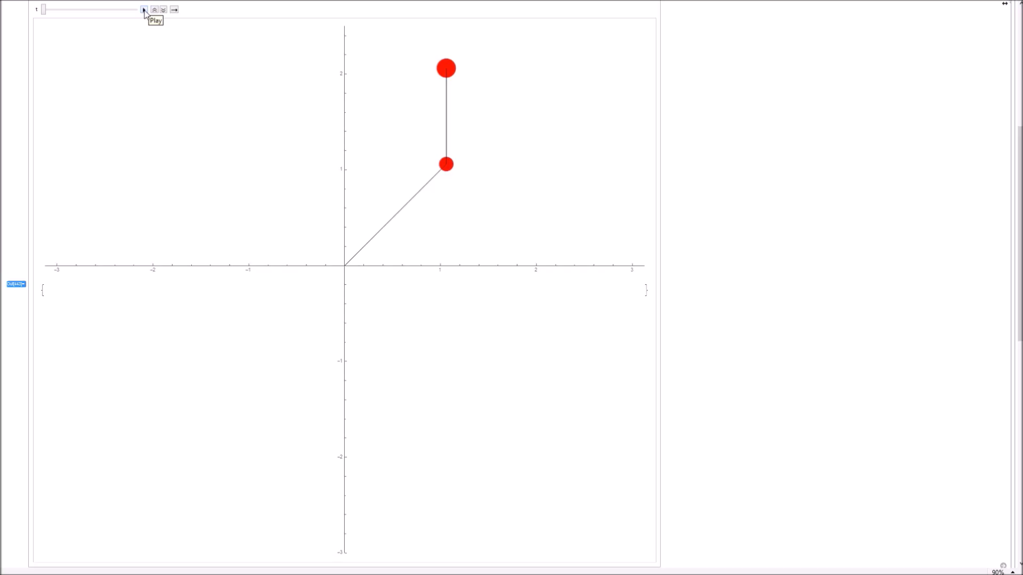
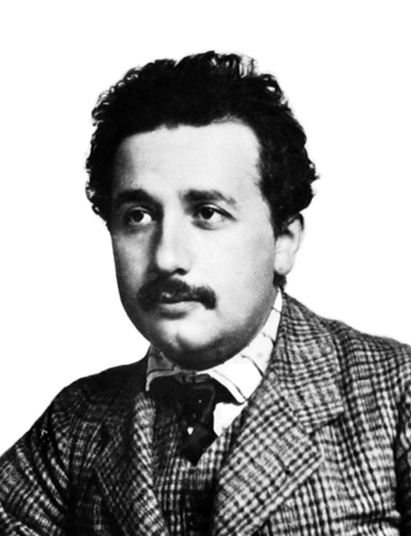
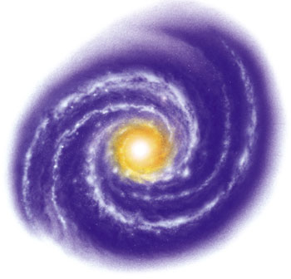

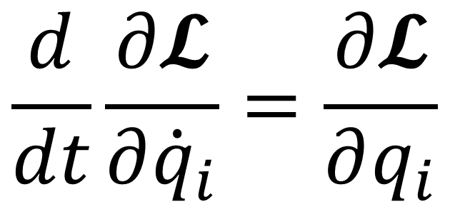
Lagrangians
& Special Relativity
$$\frac{d}{dt}\frac{∂𝓛}{∂{\dot{q}}_{i}}=\frac{∂𝓛}{∂q_{i}}$$

Slide 2
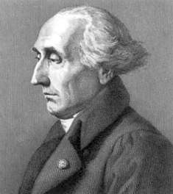
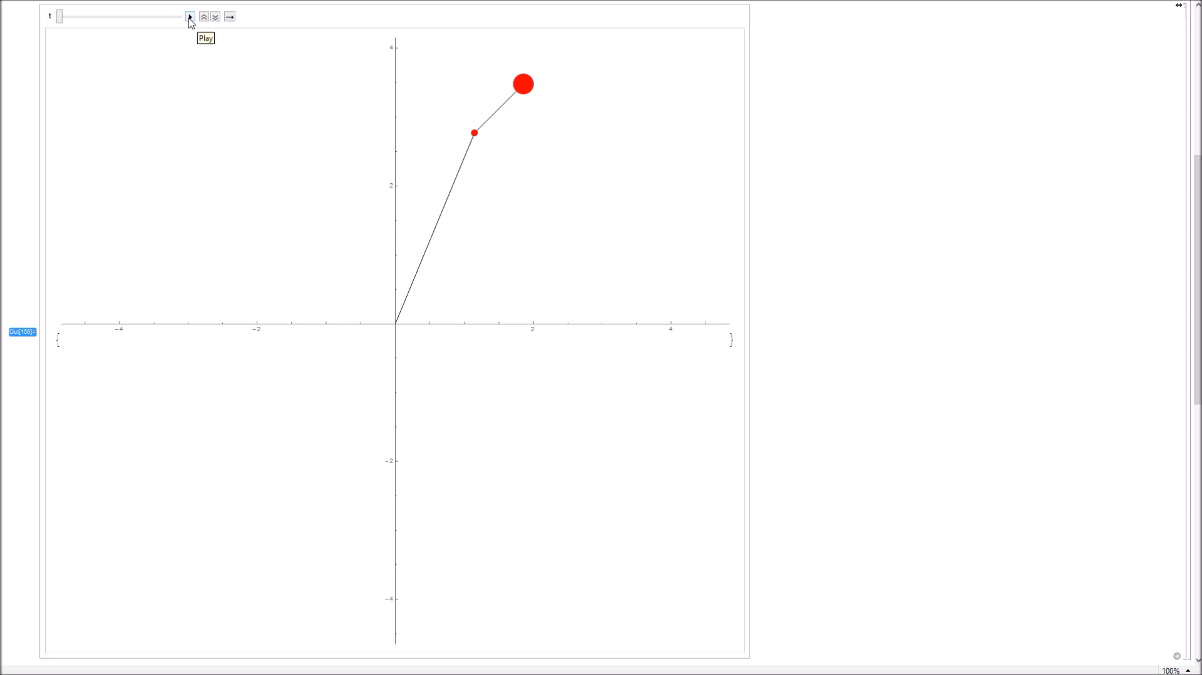
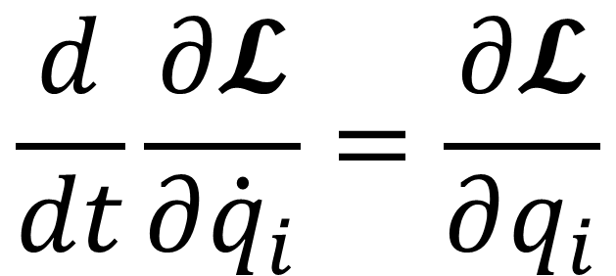
Lagrangian Mechanics
$$\frac{d}{dt}\frac{∂𝓛}{∂{\dot{q}}_{i}}=\frac{∂𝓛}{∂q_{i}}$$

Slide 3
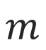


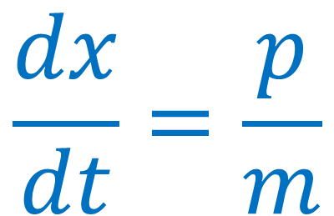

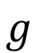


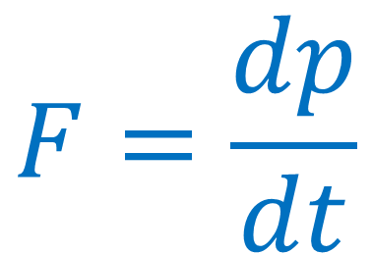

Newton’s Laws
$$\frac{dx}{dt}=\frac{p}{m}$$
$$θ$$
$$l$$
$$m$$
$$F=\frac{dp}{dt}$$
$$g$$
$$α$$
$$L$$
$$M$$
VERY
Difficult…
$$F_{AB}=−F_{BA}$$

Slide 4
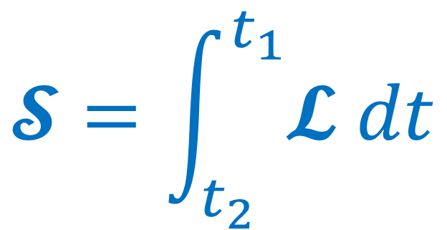
Principle of Least Action
Action, S, is a time integral of energy
The action of a system between two times is larger if the time interval is longer or the energy is higher
Particles tend to lower their potential energy as much as possible, leading to this principle
$$𝓢=\int_{t_{2}}^{t_{1}}{𝓛 dt}$$

Slide 5
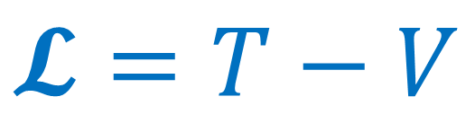
Principle of Least Action
The energy term in the integral is the Lagrangian, which takes the form:
$$𝓢=\int_{t_{2}}^{t_{1}}{𝓛 dt}$$
$$𝓛=T−V$$
$$𝓛=Kinetic Energy−Potential Energy$$

Slide 6
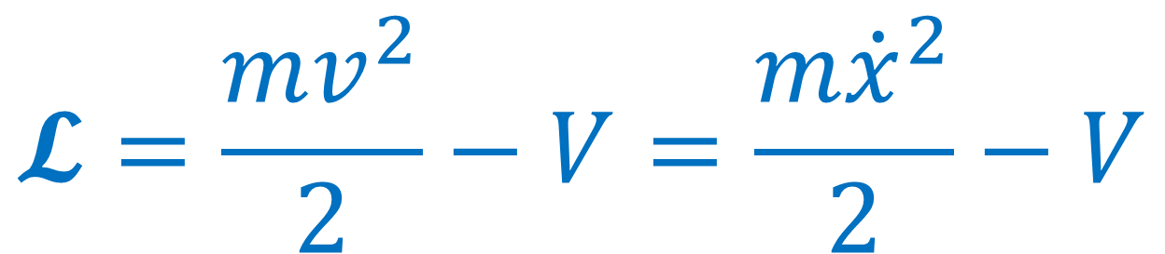
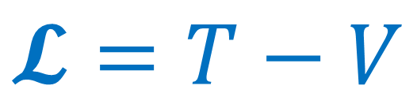
Simple Lagrangian
For example, for one particle:
$$𝓛=T−V$$
$$𝓛=\frac{mv^{2}}{2}−V=\frac{m{\dot{x}}^{2}}{2}−V$$

Slide 7
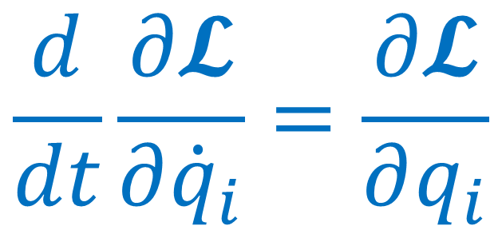
Euler-Lagrange Equations
An equation can be derived from multiple principles of classical physics that gives the equations of motion of a system from the Lagrangian:
$$\frac{d}{dt}\frac{∂𝓛}{∂{\dot{q}}_{i}}=\frac{∂𝓛}{∂q_{i}}$$
Where q could be a linear coordinate (x, y, z etc.), an angular coordinate (θ, α etc.) or any other

Slide 8
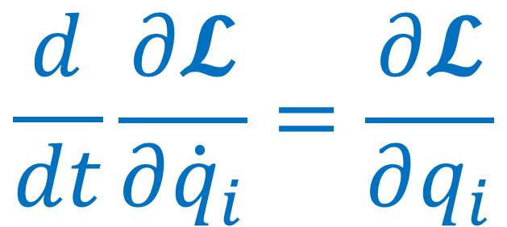
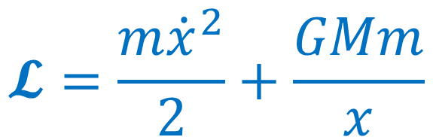
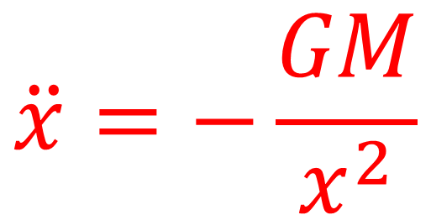
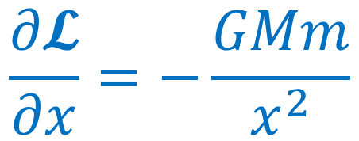
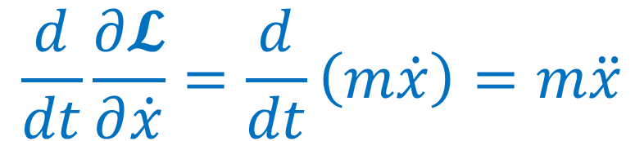
One Particle in Gravitational Field
$$𝓛=\frac{m{\dot{x}}^{2}}{2}+\frac{GMm}{x}$$
$$\frac{d}{dt}\frac{∂𝓛}{∂{\dot{q}}_{i}}=\frac{∂𝓛}{∂q_{i}}$$
$$\frac{d}{dt}\frac{∂𝓛}{∂\dot{x}}=\frac{d}{dt}\left(m\dot{x}\right)=m\ddot{x}$$
$$\ddot{x}=−\frac{GM}{x^{2}}$$
$$\frac{∂𝓛}{∂x}=−\frac{GMm}{x^{2}}$$

Slide 9
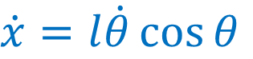
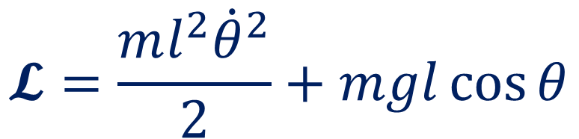
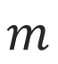
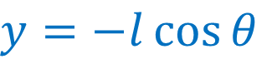
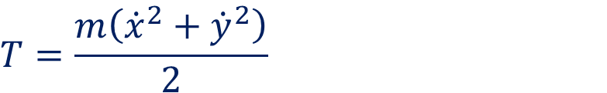

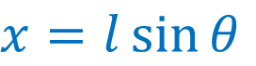
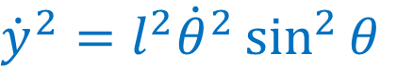
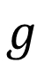
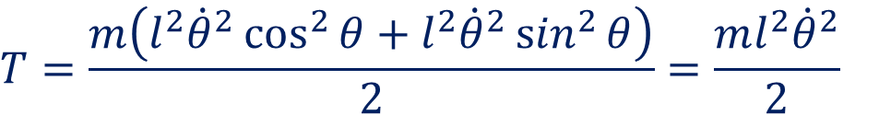


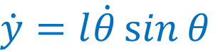
Single Pendulum
$$x=l\sin{θ}$$
$$y=−l\cos{θ}$$
$$θ$$
$$l$$
$$\dot{x}=l\dot{θ}\cos{θ}$$
$$\dot{y}=l\dot{θ}\sin{θ}$$
$${\dot{x}}^{2}=l^{2}{\dot{θ}}^{2}\cos^{2}{θ}$$
$${\dot{y}}^{2}=l^{2}{\dot{θ}}^{2}\sin^{2}{θ}$$
$$m$$
$$g$$
$$V=mgy=−mgl\cos{θ}$$
$$T=\frac{m\left({\dot{x}}^{2}+{\dot{y}}^{2}\right)}{2}$$
$$𝓛=\frac{ml^{2}{\dot{θ}}^{2}}{2}+mgl\cos{θ}$$
$$T=\frac{m\left(l^{2}{\dot{θ}}^{2}\cos^{2}{θ}+l^{2}{\dot{θ}}^{2}\sin^{2}{θ}\right)}{2}=\frac{ml^{2}{\dot{θ}}^{2}}{2}$$

Slide 10
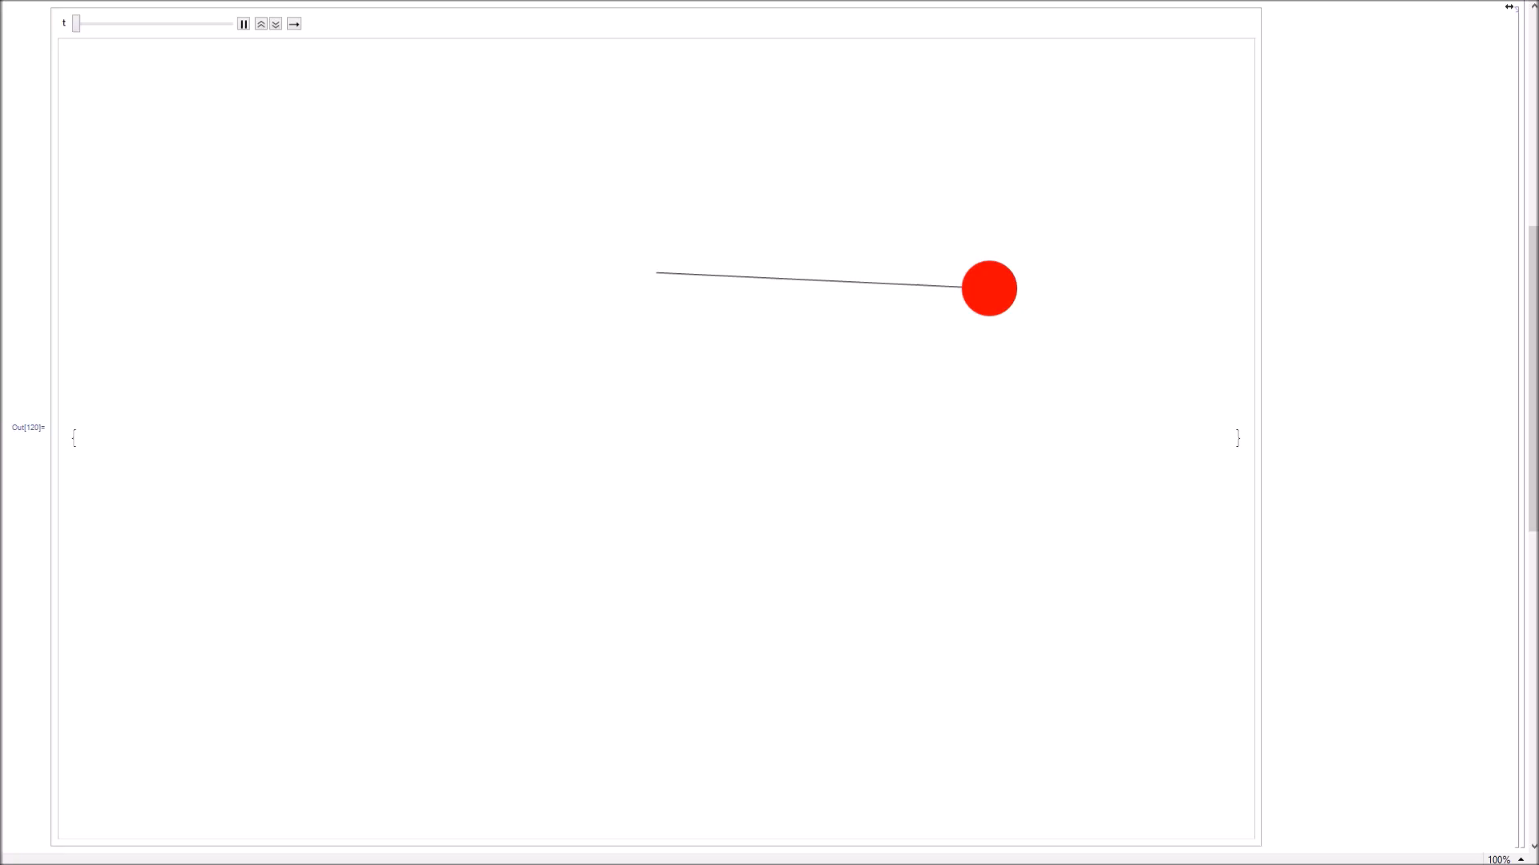
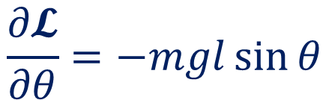
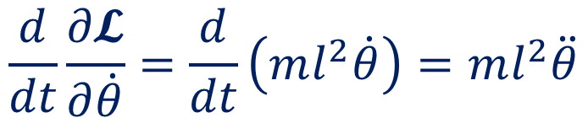
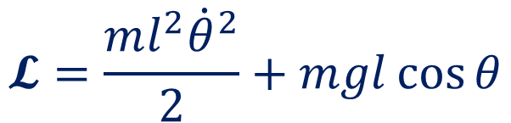

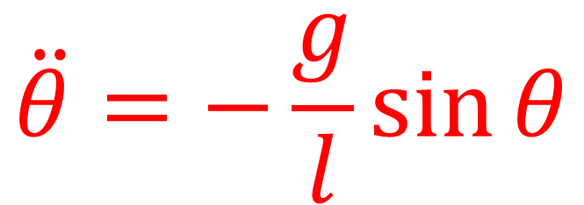
Single Pendulum
$$𝓛=\frac{ml^{2}{\dot{θ}}^{2}}{2}+mgl\cos{θ}$$
$$\frac{d}{dt}\frac{∂𝓛}{∂\dot{θ}}=\frac{d}{dt}\left(ml^{2}\dot{θ}\right)=ml^{2}\ddot{θ}$$
$$\frac{∂𝓛}{∂θ}=−mgl\sin{θ}$$
$$ml^{2}\ddot{θ}=−mgl\sin{θ}$$
$$\ddot{θ}=−\frac{g}{l}\sin{θ}$$

Slide 11
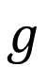


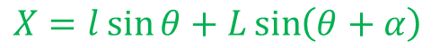


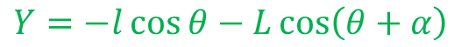
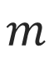
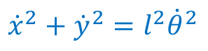

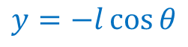
Double Pendulum
$$y=−l\cos{θ}$$
$${\dot{x}}^{2}+{\dot{y}}^{2}=l^{2}{\dot{θ}}^{2}$$
$$X=l\sin{θ}+L\sin\left(θ+α\right)$$
$$θ$$
$$l$$
$$Y=−l\cos{θ}−L\cos\left(θ+α\right)$$
$$\dot{X}=l\dot{θ}\cos{θ}+L\left(\dot{θ}+\dot{α}\right)\cos\left(θ+α\right)$$
$$m$$
$$g$$
$$L$$
$$\dot{Y}=l\dot{θ}\sin{θ}+L\left(\dot{θ}+\dot{α}\right)\sin\left(θ+α\right)$$
$$M$$
$$α$$
$${\dot{X}}^{2}=l^{2}{\dot{θ}}^{2}\cos^{2}{θ}+2lL\dot{θ}\left(\dot{θ}+\dot{α}\right)\cos{θ}\cos\left(θ+α\right)+L^{2}{\left(\dot{θ}+\dot{α}\right)}^{2}\cos^{2}\left(θ+α\right)$$
$${\dot{Y}}^{2}=l^{2}{\dot{θ}}^{2}\sin^{2}{θ}+2lL\dot{θ}\left(\dot{θ}+\dot{α}\right)\sin{θ}\sin\left(θ+α\right)+L^{2}{\left(\dot{θ}+\dot{α}\right)}^{2}\sin^{2}\left(θ+α\right)$$
$${\dot{X}}^{2}+{\dot{Y}}^{2}=\left(l^{2}+L^{2}\right){\dot{θ}}^{2}+L^{2}{\dot{α}}^{2}+2lL\dot{θ}\left(\dot{θ}+\dot{α}\right)\cos\left(α\right)+2L^{2}\dot{θ}\dot{α}$$

Slide 12
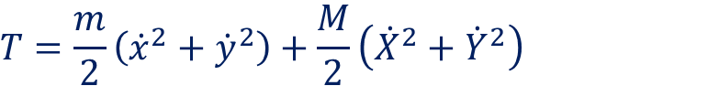
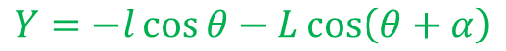

Double Pendulum
$$y=−l\cos{θ}$$
$${\dot{x}}^{2}+{\dot{y}}^{2}=l^{2}{\dot{θ}}^{2}$$
$$Y=−l\cos{θ}−L\cos\left(θ+α\right)$$
$$θ$$
$$l$$
$${\dot{X}}^{2}+{\dot{Y}}^{2}=\left(l^{2}+L^{2}\right){\dot{θ}}^{2}+L^{2}{\dot{α}}^{2}+2lL\dot{θ}\left(\dot{θ}+\dot{α}\right)\cos\left(α\right)+2L^{2}\dot{θ}\dot{α}$$
$$V=mgy+MgY=−\left(m+M\right)gl\cos{θ}−MgL\cos\left(θ+α\right)$$
$$m$$
$$g$$
$$L$$
$$M$$
$$T=\frac{m}{2}\left({\dot{x}}^{2}+{\dot{y}}^{2}\right)+\frac{M}{2}\left({\dot{X}}^{2}+{\dot{Y}}^{2}\right)$$
$$α$$
$$=\frac{m}{2}l^{2}{\dot{θ}}^{2}+\frac{M}{2}\left(\left(l^{2}+L^{2}\right){\dot{θ}}^{2}+L^{2}{\dot{α}}^{2}+2lL\dot{θ}\left(\dot{θ}+\dot{α}\right)\cos\left(α\right)+2L^{2}\dot{θ}\dot{α}\right)$$
$$𝓛=\frac{m}{2}l^{2}{\dot{θ}}^{2}+\frac{M}{2}\left(\left(l^{2}+L^{2}\right){\dot{θ}}^{2}+L^{2}{\dot{α}}^{2}+2lL\dot{θ}\left(\dot{θ}+\dot{α}\right)\cos\left(α\right)+2L^{2}\dot{θ}\dot{α}\right)+\left(m+M\right)gl\cos{θ}+MgL\cos\left(θ+α\right)$$

Slide 13
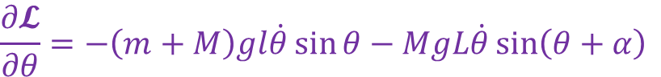
Double Pendulum
$$𝓛=\frac{m}{2}l^{2}{\dot{θ}}^{2}+\frac{M}{2}\left(\left(l^{2}+L^{2}\right){\dot{θ}}^{2}+L^{2}{\dot{α}}^{2}+2lL\dot{θ}\left(\dot{θ}+\dot{α}\right)\cos\left(α\right)+2L^{2}\dot{θ}\dot{α}\right)+\left(m+M\right)gl\cos{θ}+MgL\cos\left(θ+α\right)$$
$$\frac{d}{dt}\frac{∂𝓛}{∂\dot{θ}}=\frac{d}{dt}\left(ml^{2}\dot{θ}+M\left(\left(l^{2}+L^{2}\right)\dot{θ}+lL\left(2\dot{θ}+\dot{α}\right)\cos\left(α\right)+L^{2}\dot{α}\right)\right)$$
$$\frac{d}{dt}\frac{∂𝓛}{∂\dot{θ}}=ml^{2}\ddot{θ}+M\left(\left(l^{2}+L^{2}\right)\ddot{θ}+lL\left(2\ddot{θ}+\ddot{α}\right)\cos\left(α\right)−lL\dot{α}\left(2\dot{θ}+\dot{α}\right)\sin\left(α\right)+L^{2}\ddot{α}\right)$$
$$\frac{∂𝓛}{∂θ}=−\left(m+M\right)gl\dot{θ}\sin{θ}−MgL\dot{θ}\sin\left(θ+α\right)$$
$$ml^{2}\ddot{θ}+M\left(\left(l^{2}+L^{2}\right)\ddot{θ}+lL\left(2\ddot{θ}+\ddot{α}\right)\cos\left(α\right)−lL\dot{α}\left(2\dot{θ}+\dot{α}\right)\sin\left(α\right)+L^{2}\ddot{α}\right)+\left(m+M\right)gl\dot{θ}\sin{θ}+MgL\dot{θ}\sin\left(θ+α\right)=0$$

Slide 14
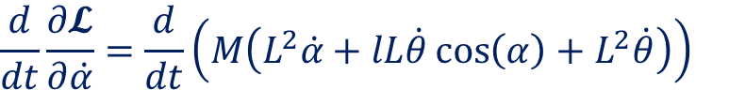
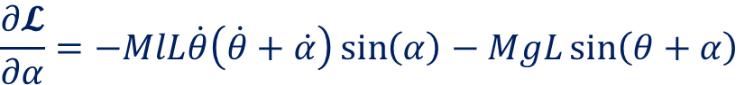
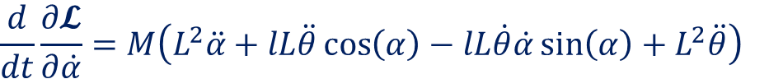
Double Pendulum
$$𝓛=\frac{m}{2}l^{2}{\dot{θ}}^{2}+\frac{M}{2}\left(\left(l^{2}+L^{2}\right){\dot{θ}}^{2}+L^{2}{\dot{α}}^{2}+2lL\dot{θ}\left(\dot{θ}+\dot{α}\right)\cos\left(α\right)+2L^{2}\dot{θ}\dot{α}\right)+\left(m+M\right)gl\cos{θ}+MgL\cos\left(θ+α\right)$$
$$\frac{d}{dt}\frac{∂𝓛}{∂\dot{α}}=\frac{d}{dt}\left(M\left(L^{2}\dot{α}+lL\dot{θ}\cos\left(α\right)+L^{2}\dot{θ}\right)\right)$$
$$\frac{d}{dt}\frac{∂𝓛}{∂\dot{α}}=M\left(L^{2}\ddot{α}+lL\ddot{θ}\cos\left(α\right)−lL\dot{θ}\dot{α}\sin\left(α\right)+L^{2}\ddot{θ}\right)$$
$$\frac{∂𝓛}{∂α}=−MlL\dot{θ}\left(\dot{θ}+\dot{α}\right)\sin\left(α\right)−MgL\sin\left(θ+α\right)$$
$$M\left(L^{2}\ddot{α}+lL\ddot{θ}\cos\left(α\right)−lL\dot{θ}\dot{α}\sin\left(α\right)+L^{2}\ddot{θ}\right)+MlL\dot{θ}\left(\dot{θ}+\dot{α}\right)\sin\left(α\right)+MgL\sin\left(θ+α\right)=0$$

Slide 15
Double Pendulum
$$ml^{2}\ddot{θ}+M\left(\left(l^{2}+L^{2}\right)\ddot{θ}+lL\left(2\ddot{θ}+\ddot{α}\right)\cos\left(α\right)−lL\dot{α}\left(2\dot{θ}+\dot{α}\right)\sin\left(α\right)+L^{2}\ddot{α}\right)+\left(m+M\right)gl\dot{θ}\sin{θ}+MgL\dot{θ}\sin\left(θ+α\right)=0$$
$$M\left(L^{2}\ddot{α}+lL\ddot{θ}\cos\left(α\right)−lL\dot{θ}\dot{α}\sin\left(α\right)+L^{2}\ddot{θ}\right)+MlL\dot{θ}\left(\dot{θ}+\dot{α}\right)\sin\left(α\right)+MgL\sin\left(θ+α\right)=0$$

Slide 16


Acceleration in
Special Relativity
Tom Dodd
$$αt=γv$$

Slide 17








The Problem
$$u=c$$
$$v=0$$
$$v=c/2$$
$$u^{′}=c/2$$
$$u^{′}=c$$
$$u^{′}=u−v$$

Slide 18



The Problem
The speed of light is always the same, in all reference frames
?
$$c=\frac{1}{\sqrt{μ_{0}∙ε_{0}}}$$
$$u^{′}=c$$
$$u^{′}=c/2$$

Slide 19



Transformations
$$x^{′}=x−vt$$
$$t^{′}=t$$
WRONG!

Slide 20


Transformations
$$x^{′}=γ(x−vt)$$
$$x^{′}=x−vt$$
$$t^{′}=t$$
$$t^{′}=γ\left(t−\frac{vx}{c^{2}}\right)$$

Slide 21





The Lorentz Factor
$$\{$$
$$cτ$$
$$τ$$
$$x$$

Slide 22











The Lorentz Factor
$$ct$$
$$cτ$$
$$cτ$$
$$vt$$
$${\left(ct\right)}^{2}={\left(cτ\right)}^{2}+{\left(vt\right)}^{2}$$
$$t^{2}\left(1−\frac{v^{2}}{c^{2}}\right)=τ^{2}$$
$$t=\frac{τ}{\sqrt{1−\frac{v^{2}}{c^{2}}}}$$
$$c^{2}t^{2}−v^{2}t^{2}=c^{2}τ^{2}$$
$$t^{2}=\frac{τ^{2}}{1−\frac{v^{2}}{c^{2}}}$$
$$t^{2}−\frac{v^{2}}{c^{2}}t^{2}=τ^{2}$$
$$t=γτ$$

Slide 23




Velocity Addition
$$t^{′}=γ\left(t−\frac{vx}{c^{2}}\right)$$
$$x^{′}=γ(x−vt)$$
$$u^{′}=\frac{dx^{′}}{dt^{′}}=\frac{dx′}{dt}÷\frac{dt^{′}}{dt}$$
$$u^{′}=γ\left(u−v\right)÷γ\left(1−\frac{uv}{c^{2}}\right)=\frac{u−v}{1−\frac{uv}{c^{2}}}$$

Slide 24


Velocity Addition
$$u^{′}=\frac{u−v}{1−\frac{uv}{c^{2}}}$$
$$u^{′}=u−v$$

Slide 25




Velocity Addition
$$v=\frac{−3}{4}c$$
$$u=\frac{3}{4}c$$
$$u^{′}=\frac{u−v}{1−\frac{uv}{c^{2}}}=0.96∙c$$
$$u^{′}=u−v=1.5∙c$$

Slide 26




Acceleration
$$u^{′}=\frac{u−v}{1−\frac{uv}{c^{2}}}$$
$$t^{′}=γ\left(t−\frac{vx}{c^{2}}\right)$$
$$a^{′}=\frac{du^{′}}{dt^{′}}=\frac{du′}{dt}÷\frac{dt^{′}}{dt}$$
$$\frac{du′}{dt}=\frac{a\left(1−\frac{uv}{c^{2}}\right)−\left(u−v\right)\left(−\frac{av}{c^{2}}\right)}{{\left(1−\frac{uv}{c^{2}}\right)}^{2}}$$

Slide 27



Acceleration
$$\frac{du′}{dt}=\frac{a\left(1−\frac{uv}{c^{2}}\right)−\left(u−v\right)\left(−\frac{av}{c^{2}}\right)}{{\left(1−\frac{uv}{c^{2}}\right)}^{2}}$$
$$\frac{du′}{dt}=\frac{a−\frac{auv}{c^{2}}+\frac{uav}{c^{2}}−\frac{av^{2}}{c^{2}}}{{\left(1−\frac{uv}{c^{2}}\right)}^{2}}=\frac{a\left(1−\frac{v^{2}}{c^{2}}\right)}{{\left(1−\frac{uv}{c^{2}}\right)}^{2}}$$
$$\frac{du′}{dt}=\frac{a}{γ^{2}{\left(1−\frac{uv}{c^{2}}\right)}^{2}}$$

Slide 28





Acceleration
$$\frac{du′}{dt}=\frac{a}{{γ^{2}\left(1−\frac{uv}{c^{2}}\right)}^{2}}$$
$$\frac{dt^{′}}{dt}=γ\left(1−\frac{uv}{c^{2}}\right)$$
$$a^{′}=\frac{du′}{dt}÷\frac{dt^{′}}{dt}=\frac{a}{{γ^{2}\left(1−\frac{uv}{c^{2}}\right)}^{2}}×\frac{1}{γ\left(1−\frac{uv}{c^{2}}\right)}$$
$$a^{′}=\frac{a}{{γ^{3}\left(1−\frac{uv}{c^{2}}\right)}^{3}}$$
$$Classical: a^{′}=a$$

Slide 29



Acceleration
$$a^{′}=\frac{a}{{γ^{3}\left(1−\frac{uv}{c^{2}}\right)}^{3}}$$
If u=v, we transform into the
accelerating reference frame
$$a^{′}→α=\frac{a}{{γ^{3}\left(1−\frac{v^{2}}{c^{2}}\right)}^{3}}=\frac{γ^{6}a}{γ^{3}}$$
$$α=γ^{3}a$$
Constant acceleration experienced by accelerating frame – the ‘proper acceleration’

Slide 30



Relativistic SUVAT
$$α=γ^{3}a=γ^{3}\frac{du}{dt}=γ^{3}\frac{dv}{dt}$$
We will assume the initial velocity, u, is equal to 0
$$α dt=γ^{3} dv → \int{α dt}=\int{γ^{3} dv}$$
$$αt=\int{\frac{1}{{\left(1−\frac{v^{2}}{c^{2}}\right)}^{3/2}} dv}$$

Slide 31



Relativistic SUVAT
$$αt=\int{\frac{1}{{\left(1−\frac{v^{2}}{c^{2}}\right)}^{3/2}} dv}=\frac{v}{\sqrt{1−\frac{v^{2}}{c^{2}}}}$$
$$αt=γv$$
$$Classical: αt=v=at$$

Slide 32






Velocity
$$αt=\frac{v}{\sqrt{1−\frac{v^{2}}{c^{2}}}}$$
$$α^{2}t^{2}=\frac{v^{2}}{1−\frac{v^{2}}{c^{2}}}$$
$$α^{2}t^{2}−\frac{{α^{2}t^{2}v}^{2}}{c^{2}}=v^{2}$$
$$v=\frac{αt}{\sqrt{1+\frac{α^{2}t^{2}}{c^{2}}}}$$
$$α^{2}t^{2}=v^{2}+\frac{{α^{2}t^{2}v}^{2}}{c^{2}}=v^{2}\left(1+\frac{α^{2}t^{2}}{c^{2}}\right)$$
$$\frac{α^{2}t^{2}}{1+\frac{α^{2}t^{2}}{c^{2}}}=v^{2}$$

Slide 33



Displacement
$$\int{v dt}=\int{\frac{αt}{\sqrt{1+\frac{α^{2}t^{2}}{c^{2}}}} dt}=s$$
Assuming the initial displacement, s₀, is equal to 0
$$s=\frac{c^{2}}{α}\sqrt{1+\frac{α^{2}t^{2}}{c^{2}}}−\frac{c^{2}}{α}$$
$$Classical: s=\frac{at^{2} }{2}$$

Slide 34



Proper Time
$$t=γτ$$
The time experienced in the accelerating reference frame
$$γ=\frac{t}{τ} → \frac{dt}{dτ}$$
$$α=γ^{3}\frac{dv}{dt}=γ^{2}\frac{dt}{dτ}\frac{dv}{dt}=γ^{2}\frac{dv}{dτ}$$

Slide 35




Proper Time
$$α=γ^{2}\frac{dv}{dτ}$$
$$α dτ=γ^{2} dv → \int{α dτ}=\int{γ^{2} dv}$$
$$ατ=\int{\frac{1}{1−\frac{v^{2}}{c^{2}}} dv}=c\tanh^{−1}{\frac{v}{c}}$$
$$τ=\frac{c}{α}\tanh^{−1}{\frac{v}{c}}$$

Slide 36








All Equations
$$α=γ^{3}a$$
$$α=a$$
$$v=\frac{αt}{\sqrt{1+\frac{α^{2}t^{2}}{c^{2}}}}$$
$$v=at$$
$$s=\frac{c^{2}}{α}\sqrt{1+\frac{α^{2}t^{2}}{c^{2}}}−\frac{c^{2}}{α}$$
$$s=\frac{at^{2} }{2}$$
$$τ=\frac{c}{α}\tanh^{−1}{\frac{v}{c}}$$
$$τ=\frac{v}{a}=t$$

Slide 37








Example
Rocket travels to Andromeda – accelerates at 10 ms⁻² for half the journey, then decelerates at 10 ms⁻² for the other half
$$t=t_{1}+t_{2}$$
$$α_{1}=10 ms^{−2}$$
$$s=2.4∗{10}^{22} m$$
$$t_{1}=t_{2}$$
$$s_{1}=1.2∗{10}^{22} m$$
$$t=2t_{1}$$

Slide 38




Example
$$s=\frac{c^{2}}{α}\sqrt{1+\frac{α^{2}t^{2}}{c^{2}}}−\frac{c^{2}}{α}$$
$$t=\frac{\sqrt{s}\sqrt{αs+2c^{2}}}{c\sqrt{α}}$$
$$t_{1}=\frac{\sqrt{1.2∗{10}^{22}}\sqrt{10∗1.2∗{10}^{22}+2∗{299792458}^{2}}}{299792458∗\sqrt{10}}=4∗{10}^{13} s$$
$$t=2∗4∗{10}^{13} s=8∗{10}^{13} s$$

Slide 39

Example
$$v=\frac{αt}{\sqrt{1+\frac{α^{2}t^{2}}{c^{2}}}}=\frac{10∗4∗{10}^{13}}{\sqrt{1+\frac{{10}^{2}∗{\left(4∗{10}^{13}\right)}^{2}}{{299792458}^{2}}}}=c−8.42∗{10}^{−5} ms^{−1}$$
$$τ_{1}=\frac{c}{α}\tanh^{−1}{\frac{v}{c}}=\frac{299792458}{10}\tanh^{−1}{\frac{299792458−8.42∗{10}^{−5}}{299792458}}=4.4∗{10}^{8} s$$
$$τ=2∗4.4∗{10}^{8} s=8.8∗{10}^{8} s$$

Slide 40

Example
$$t=8∗{10}^{13} s=2.5 million years$$
$$τ=8.8∗{10}^{8} s=28 years$$
Extreme time dilation

Slide 41
Thank You For Listening
Sources:
Stanford YouTube
YaleCourses

